Slide 1

Zhenyu Cui, Stevens Institute of Technology
Rupak Chatterjee, Stevens
Chihoon Lee, Stevens
Zhiyang Deng, Stevens

Slide 2

Deliverables
Formulate practically important portfolio analysis problems.
Translate into a format amenable to be input into quantum optimization softwares.
Compare the performance of quantum optimization versus traditional optimization methods in terms of CPU time.

Slide 3
Deliverable Completion
Deliverable 1
We formulate the portfolio optimization problem as an integer programming problem, i.e. choosing whether to invest or not in each individual stock within a portfolio.
Deliverable 2
The portfolio optimization problem is written into an algorithm using Qiskit.
Deliverable 3
We use two quantum algorithms in solving the portfolio optimization problem, and compare to the classical algorithms.

Slide 4
Risks
Uncertainty in the availability of quantum optimization software.
Numerical advantage of the quantum algorithm not apparent since we have not run them on real quantum computers.
We are deciding between several providers and most likely will adopt the D-wave quantum annealer.

Slide 5
Challenges
Initial challenge we have is on the suitable financial application to focus on.
We have explored three particular applications: portfolio optimization, options pricing, solving partial differential equations systems.
In options pricing application, we do not find clear quantum advantage.

Slide 6
Mitigation Plan
Based on feedback from industry partners, we shall focus on problems that have potential of showing quantum advantage:
Calibration of implied volatility surface.
Integer programming and binary programming problems will be the focus as the quantum annealing seems to be the most promising method in showing quantum advantage.

Slide 7
Milestones
We have implemented two particular financial applications using the Qiskit package from Python, and have shown that the results obtained from quantum algorithms are consistent with those from classical algorithms.
We get ourselves familiar with the methodological details of the quantum optimization algorithms, and also using the quantum language to code. We have made a choice of using the D-wave quantum annealer in our next-step research.

Slide 8
Accomplishments & Results
Portfolio Optimization: we have tried Variational Quantum Eigensolver (VQE) algorithm, and Quantum Approximate Optimization Algorithm (QAOA). For classical algorithm, we adopt the CVXPY python package as benchmark.
We formulate the problem as an integer programming problem that only consists of binary variables.
Then we further convert it into an Ising spin glass model. After this transformation, each variable will only take one of the two eigenvalues of the related Pauli Z matrix.
After formulating the Lagrangian, we can translate the cost function into a Hamiltonian for the system of n qubits.
This enables us to apply the Variational Quantum Eigensolver (VQE) algorithm to determine the so-called ground state of the Hamiltonian, which is exactly the optimal solution to the portfolio optimization problem.

Slide 9
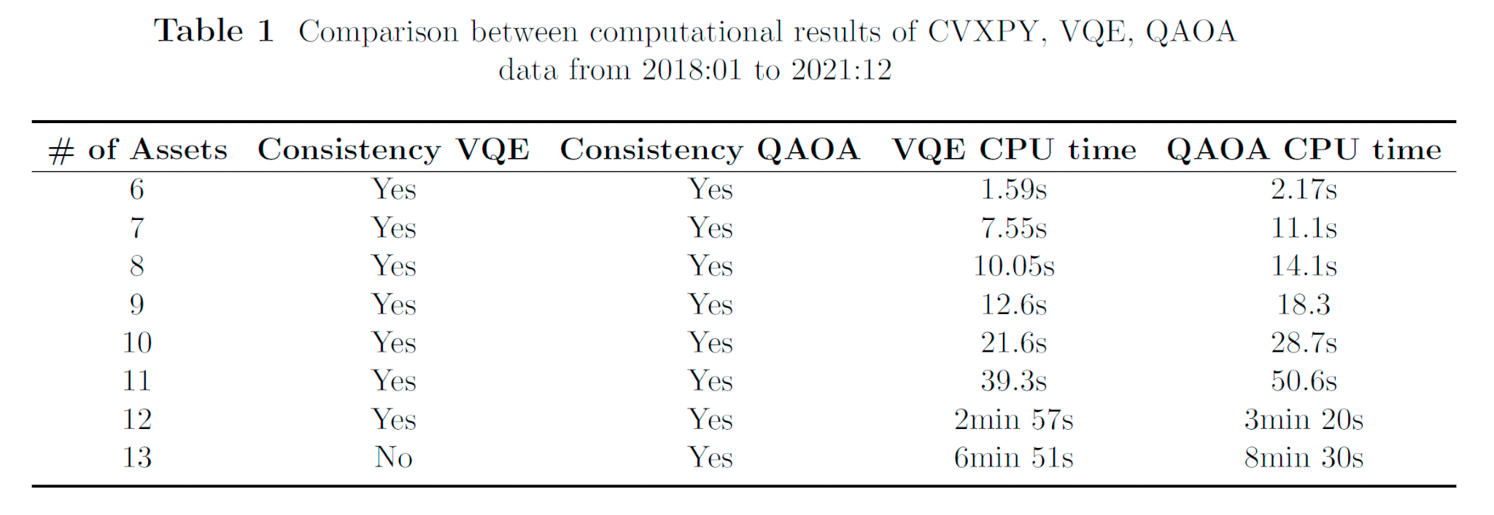
Accomplishments & Results

Slide 10
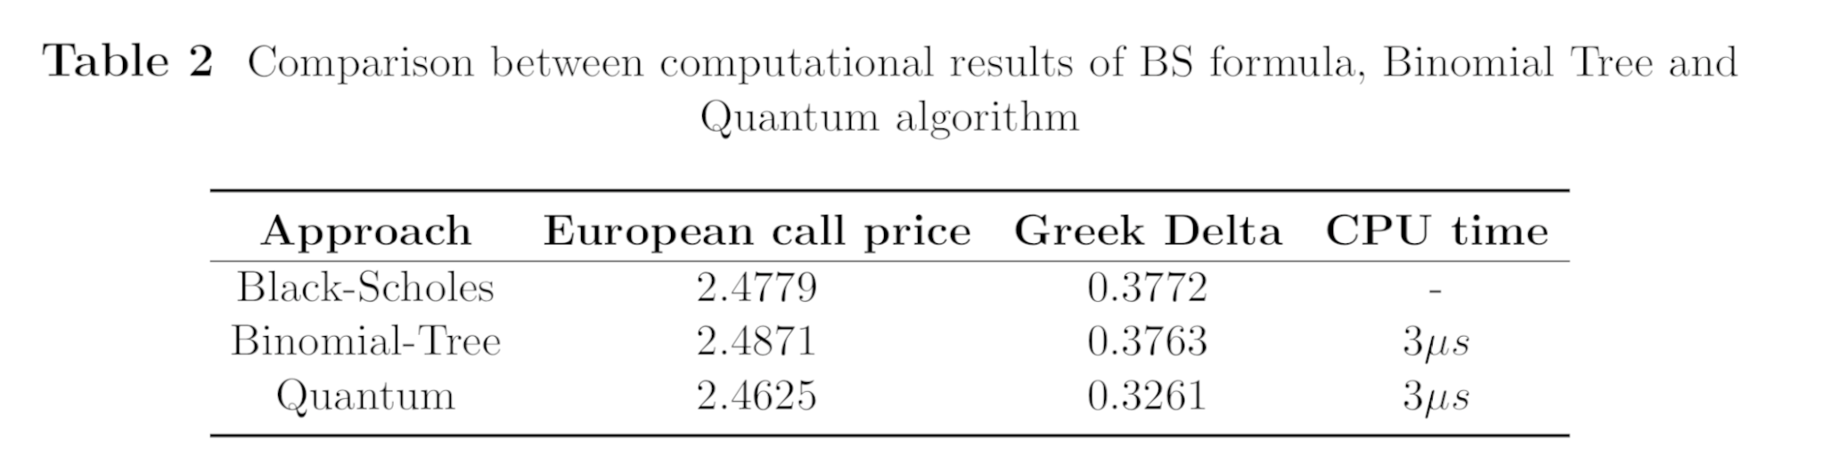
Accomplishments & Results
Options pricing: we simulate a log-normal distribution into a quantum circuit, and carry out the valuation of a European call option under the Black-Scholes model. We construct a quantum circuit to simulate a log-normal distribution into a quantum circuit.

Slide 11
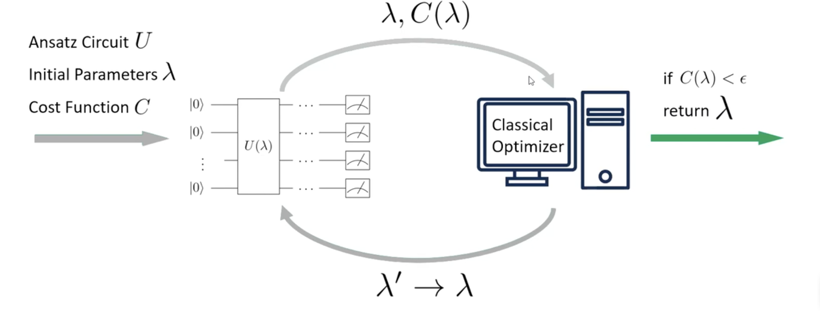
Accomplishments & Results
Solve PDE: many pricing and hedging problems in finance can be formulated as solutions to a PDE. We explore the variational quantum algorithm.

Slide 12
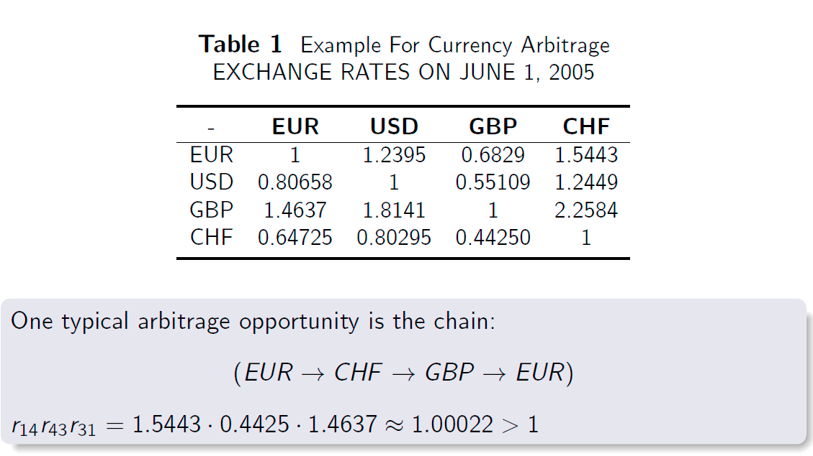
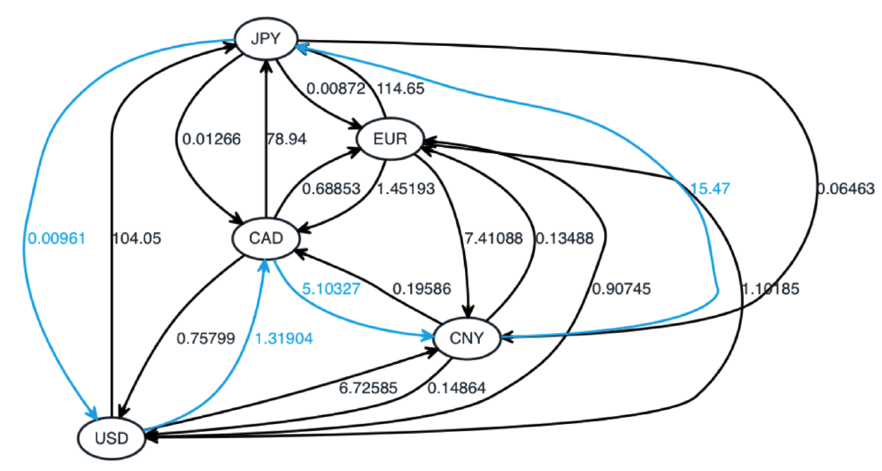
Accomplishments & Results
Foreign exchange currency arbitrage detection:

Slide 13
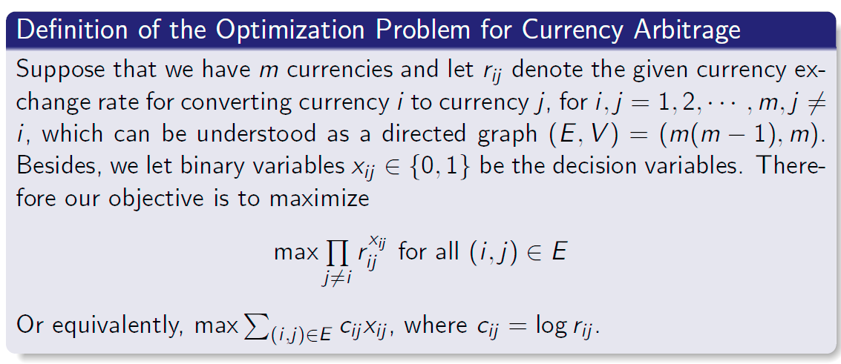
Accomplishments & Results
The arbitrage detection problem can be defined on a directed graph (E,V). t
The problem of finding the most profitable arbitrage opportunity is NP-hard.

Slide 14
Accomplishments & Results
Our goal could be to utilize this algorithm to find best arbitrage opportunity for cryptocurrencies due to their high volatility and high liquidity.
We aim to access the quantum machine developed by D-Wave because their quantum computer is very suitable for optimization problem due to their quantum annealer.
Our request: Data source for currency exchange rate or cryptocurrency exchange rate. Some assistance for programming on the D-wave quantum annealer.

Slide 15


